Slide 1
ESQC 2024
Mathematical Methods Lecture 4
By Simen Kvaal

Slide 2
Vector calculus
Functions, integration and differentiation, in one and several variables

Slide 3
Compared to yesterday ...
We studied Banach spaces of functions:
Metric measured distance between functions
Now, we study the function itself:
Now the metric measures distance in Euclidean space

Slide 4


Functions of several variables
We turn to the study of vector valued functions
Paths Scalar-valued functions

Slide 5
In quantum chemistry
One of the main reasons to study vector calculus
Most methods can be formulated as:

Slide 6
A typical domain Ω
Boxes in n dimensions
The theory handles very general shapes
Intervals are typical

Slide 7
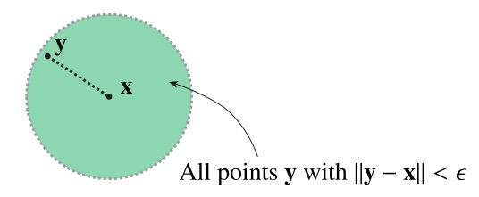
Topology of Euclidean space
Definition of an epsilon-ball

Slide 9
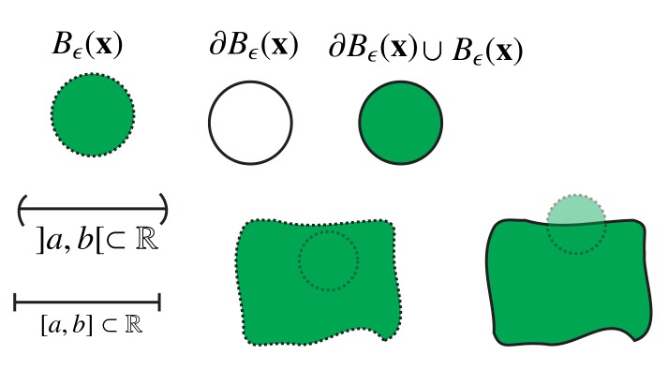
Examples

Slide 10
Neighborhood of x
Any set containing x and an open ball around x

Slide 12
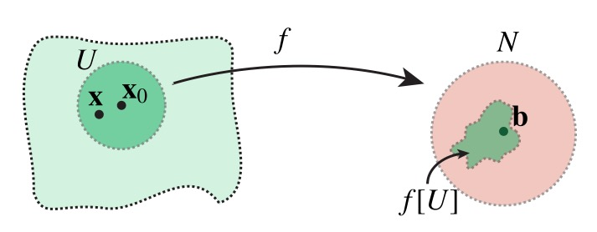
Intiuition

Slide 13
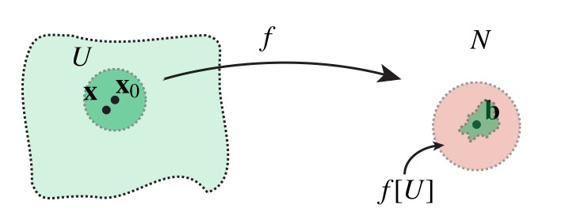
Intiuition

Slide 14
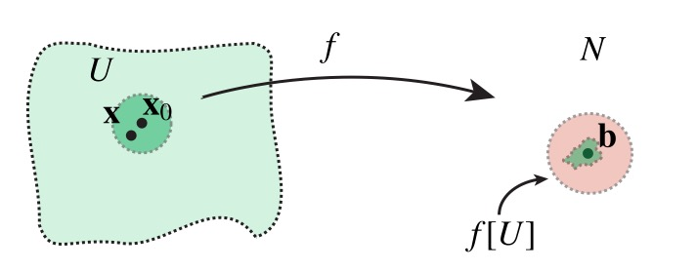
Intiuition

Slide 15
Multidimensional version of “unbroken graph”

Slide 16
Discontinuous in 1d

Slide 17
Discontinuous in 1d
However we choose U, it will betorn apart by f

Slide 18
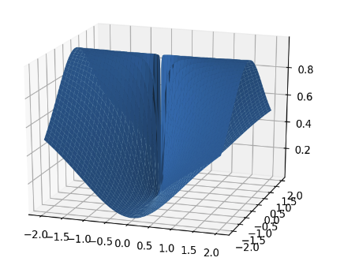
Example
Is the following function continuous at (0,0)?
(Show notebook)
No, because the limit does not exist.
Different limit candidates if we approach from different directions
The definition of limit is designed to detect

Slide 19
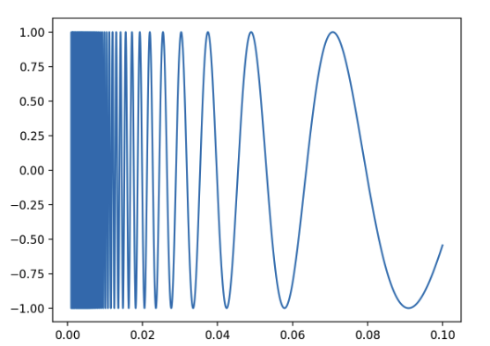
More subtle, in 1D
Is the following function continuous?
Yes, at every x in the interior of the domain
But f is discontinuous at the boundary point x = 0

Slide 21
These two theorems can be used to decide continuity of very complicated functions, once simpler functions are proven to be continuous

Slide 22
Examples
polynomials in any variable
exponential function
sine, cosine …
any composition of such
careful with division!

Slide 24
Example

Slide 25
Single-variable functions
For ”ordinary” functions f : [a,b] ⊂ℝ → ℝ, consider the derivative: if the limit exists.
Indeed, for vector-valued functions, the partial derivative is calculated as if f was a1-variable function!
All the other variables are "held constant"

Slide 26
Derivative as slope
Derivative is the slope of tangent at x
When f(x) has a derivative at x, the function can be approximated
Here y is close to x
Want something like this for vector-valued funcs

Slide 27
Derivative as slope/tangent
Partial derivative is the rate of change as one moves in one direction

Slide 28
Existence of partial derivatives seems good …
Existence of partial derivatives at a point is NOT GOOD ENOUGH!

Slide 29
What does this mean?

Slide 30
Interpretation of diffability condition
Small error term
Condition for a first-order Taylor polynomial at x₀
Generalization of the slope of the tangent line to higher dimensions

Slide 31

Intuitive, and good to know
Resolves the ugly example

Slide 32
Continuously differentiable functions
These functions can always be approximated by first-order Polynomials

Slide 33
Linearity
Linearity
Product rule
Quotient rule

Slide 34


Slide 35
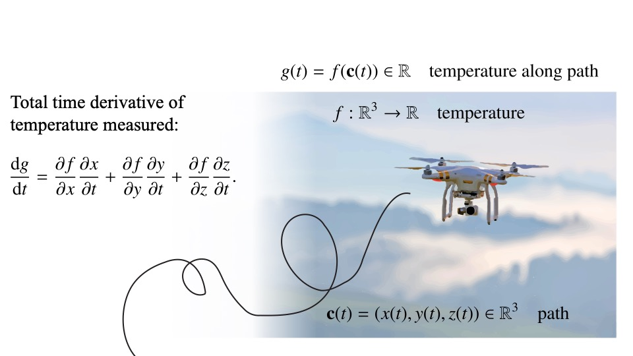
Ex: Drone measuring temperature

Slide 36
Higher derivatives
f is of class C² if the partial derivatives (matrix elements of Df) are of class C¹
Matrix elements of D(Df) = D²f: Iterated partial derivatives
Fact: If C², then partial derivatives are symmetric

Slide 37

Important for optimization!
Polynomial!

Slide 40
Critical points
Jacobian is zero
Archetypal examples of local maximum, local minimum, and saddle point

Slide 42

Further topics
Series and convergece of series
Integration over curves, surfaces, volumes ...
Vector operations: curl, divergence, gradient ...
Gauss’ and Stoke’s theorems for integration
My presentation is based on →

